Slide 1



Ethical & Legal Issues in Smart City Surveillance Systems
A Case Study in AI-Driven Urban Monitoring
16010123012 Aaryan Sharma
Notes:
1

Slide 2
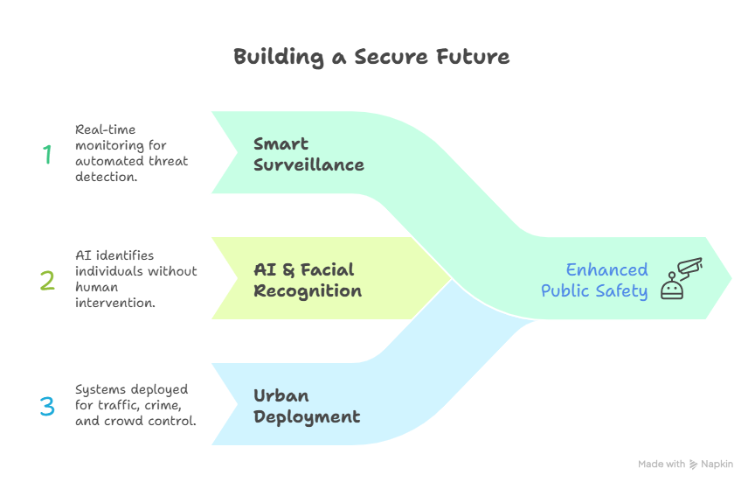
What Is Smart Surveillance?
Smart Surveillance
Integrated networks of cameras, sensors, and AI that monitor public spaces in real time, enabling automated threat detection and behavioural analysis.
AI & Facial Recognition
Deep learning models identify individuals from video feeds, cross-referencing biometric databases to flag persons of interest without human intervention.
Urban Deployment
Cities deploy these systems for traffic management, crime prevention, and crowd control — often at city-wide scale with minimal public oversight.
Notes:
2

Slide 3
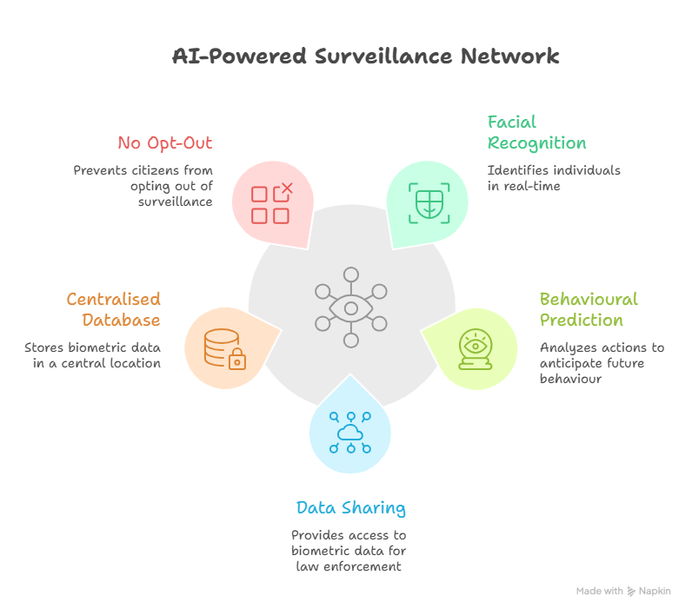
Problem Statement
The Scenario
A municipal government contracts a private firm to deploy an AI-powered surveillance network across a major city, capable of real-time facial recognition, behavioural prediction, and data sharing with law enforcement — without explicit public consent or independent oversight.
Key System Features
Predictive behaviour analysis using machine learning
No opt-out mechanism for citizens
Real-time facial recognition across public spaces
Centralised biometric database accessible by multiple agencies
Notes:
3

Slide 4
Ethical Issues
Privacy Invasion
Mass Surveillance
Continuous monitoring erodes the reasonable expectation of privacy in public spaces, capturing data on law-abiding citizens without cause.
City-wide deployment creates a panopticon effect, potentially chilling free assembly, speech, and political dissent.
Algorithmic Bias
Function Creep
Facial recognition systems demonstrate significantly higher error rates for women and ethnic minorities, leading to discriminatory outcomes.
Data collected for one purpose (e.g., traffic management) is frequently repurposed for unrelated uses without renewed consent.
Notes:
4

Slide 5
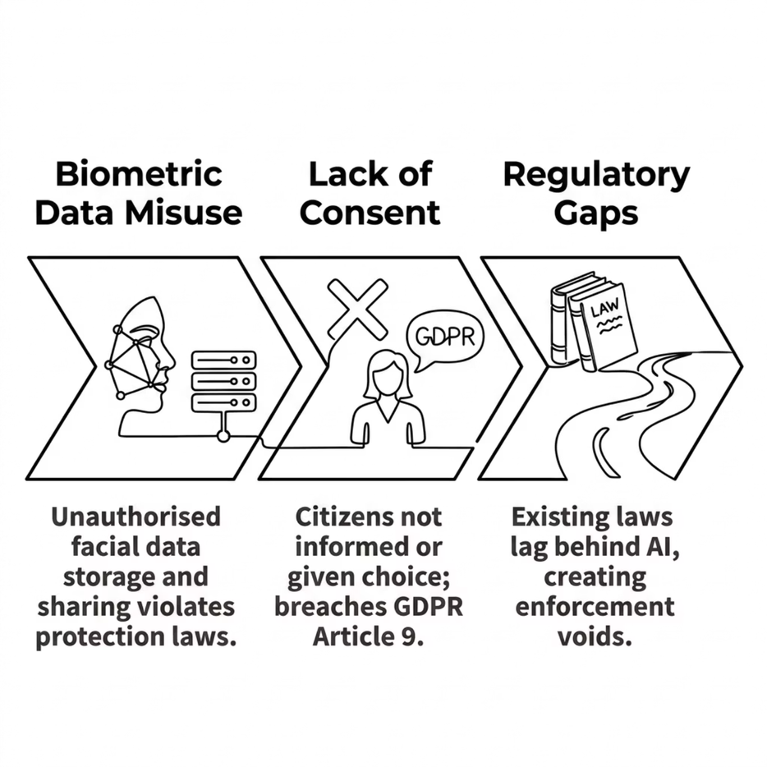
Legal Issues
Key Legal Frameworks
GDPR (EU) — Requires explicit consent for biometric processing; mandates purpose limitation and data minimisation.
Human Rights Act — Article 8 protects the right to private life; indiscriminate surveillance may constitute a violation.
AI Act (EU, 2024) — Classifies real-time biometric surveillance in public spaces as high-risk, requiring strict safeguards.
Notes:
5

Slide 6
The Core Ethical Dilemma
🔒 Security Argument
🛡️ Privacy Argument
Proponents argue that pervasive surveillance reduces crime, accelerates emergency response, and protects critical infrastructure — serving the collective good.
Critics contend that blanket surveillance is disproportionate, undermines civil liberties, and creates infrastructure vulnerable to abuse by authoritarian actors.
Crime reduction in monitored zones
Faster law enforcement response
Terrorism prevention capability
Chilling effect on free expression
Risk of mission creep and abuse
Disproportionate impact on minorities
Notes:
6

Slide 7




Stakeholder Analysis
Citizens
Government
Developers
Law Enforcement
Primary subjects of surveillance. Bear the privacy risks with limited agency or recourse. Vulnerable groups face disproportionate harm.
Commissioners and regulators. Balance public safety mandates with legal obligations and political accountability.
Engineers who design and deploy systems. Bear professional responsibility under codes such as ACM for ethical design choices.
Primary beneficiaries of surveillance data. Must operate within legal boundaries while managing public trust.
Notes:
7

Slide 8
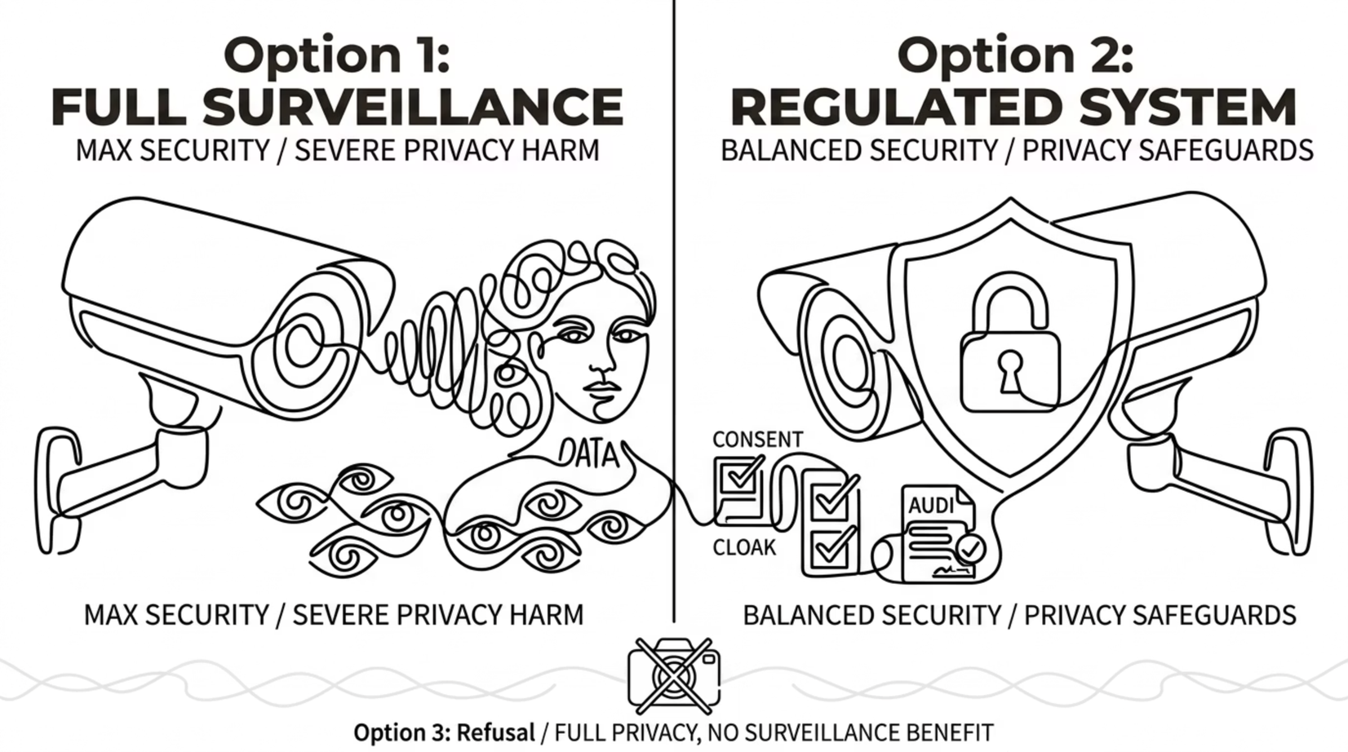
Options & Impact Assessment
Option 2 — a regulated, consent-based system with independent oversight — offers the most ethically defensible balance between security utility and civil rights protection.
Notes:
8

Slide 9

Decision & ACM Code of Ethics
Chosen Path: Regulated System
The ethically justified decision is to deploy surveillance only under strict regulatory constraints, independent oversight, and meaningful public consent mechanisms.
Identify Stakeholders
Apply ACM Principles
Implement Regulated System
01
02
03
Privacy — ACM 1.6: Respect privacy; limit data collection to what is necessary.
Fairness — ACM 1.4: Be fair and take action not to discriminate; audit algorithms for bias.
Accountability — ACM 1.3: Be honest and trustworthy; ensure transparent, auditable systems.
Notes:
9

Slide 10
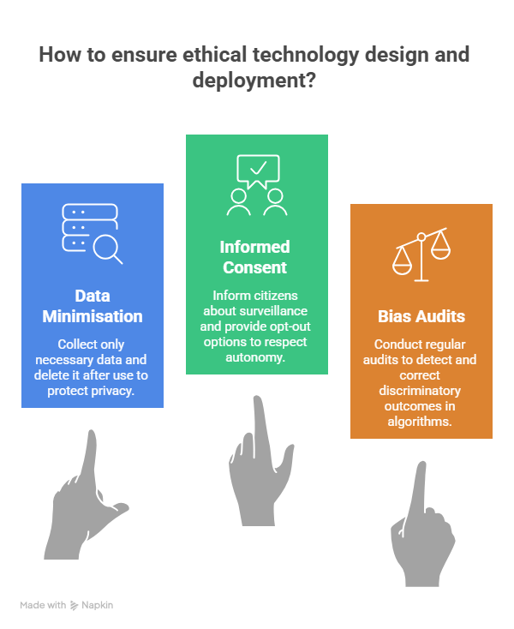
Solution & Conclusion
Data Minimisation
Collect only what is strictly necessary; delete data after its defined purpose is fulfilled.
Informed Consent
Citizens must be informed of surveillance and given meaningful opt-out mechanisms where feasible.
Bias Audits
Mandate regular third-party audits of algorithmic systems to detect and correct discriminatory outcomes.
Key Takeaway
Technology is not neutral. Engineers bear ethical responsibility for the systems they design and deploy.
Notes:
10

Slide 11
Thank You

